Slide 1
Programming concepts in general

Slide 2
Programming
Programming is a skill best acquired by practice and examples rather than from books.
-Alan Turing
Logic + Syntax + Language

Slide 3
Logic
How you solve a problem?
Algorithm

Slide 4
Syntax
Structure of the language that computer can understand.

Slide 5
Language
Language to communicate with the computer or any devices.

Slide 6
Problem solving
Understand the problem
Understand the constraints
Solve the problem

Slide 7
Compiler
Source code
Compiler
Machine code
Converts H-L language to machine code.
Machine code (0s and 1s)

Slide 8
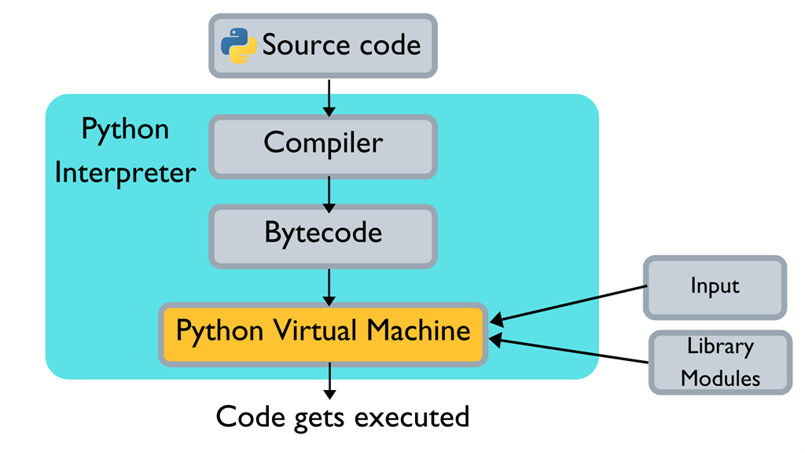
Interpreter

Slide 9
IDE
Pydev
Atom
Jupyter Notebooks
Sublime Text
VS Code
Anaconda
PyCharm
Python IDEs
Spyder

Slide 10
Important links
http://pythontutor.com/live.html#mode=edit
https://www.fullstackpython.com/best-python-resources.html
https://dronebotworkshop.com/python-free-resources/
https://www.learnpython.org/

Slide 11
Thank you

